Slide 1
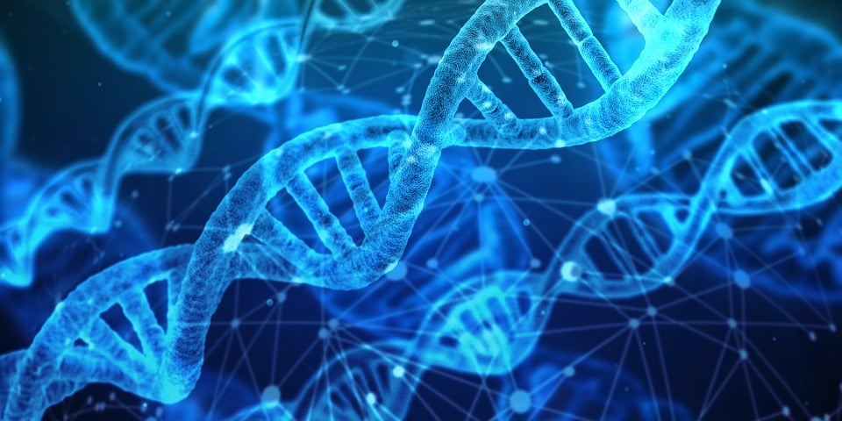
Unraveling Genetic Patterns with Linear Algebra
Chetan Mahipal,
Masumi Desai and
Erukulla Druvitha

Slide 2
INTRODUCTION:
Alleles : In genetics, an allele refers to one of the alternative forms of a gene that occupies a specific position, or locus, on a chromosome.
Role - Alleles are responsible for the variations observed in inherited traits among individuals.
Genotypes : A genotype refers to the combination of alleles that an individual possesses for a particular gene or set of genes.
Role - It represents the genetic makeup of an organism.

Slide 3
The study of alleles and genotypes is essential in understanding inheritance patterns, genetic diversity, and the transmission of traits across generations. By analyzing allele frequencies and genotypic ratios, geneticists can gain insights into the inheritance of specific traits and how they may be influenced by various factors such as natural selection or genetic drift.

Slide 4
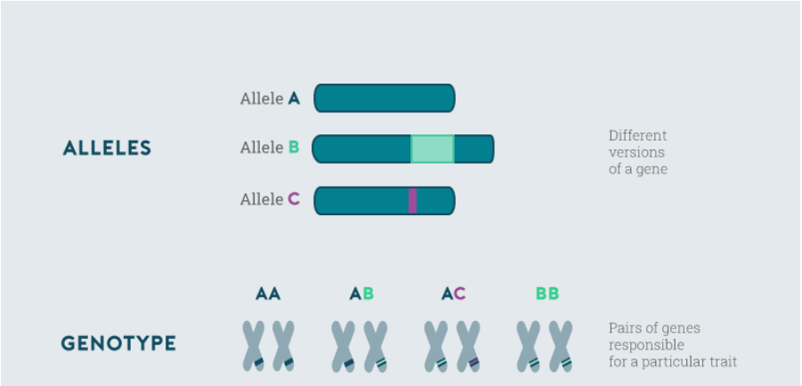

Slide 5
State of Art
Literature

Slide 6
Brief about Autosomal Inheritance
According to the research paper of Cubero (2013), Autosomal dominant inheritance or Autosomal Inheritance is a way a genetic trait or condition can be passed down from parent to offspring. Individuals inherit one gene from each parent having a pair of genes, forming their own pair of genes. The specific gene passed on to an offspring is determined by chance.
The three different types of genotypes that can be observed in a population are :
AA, aa, and Aa ( or aA )

Slide 7
By classifying individuals into these genotypic categories, it becomes possible to determine the proportions of each genotype within a population.
This information is essential for understanding the distribution and prevalence of specific alleles within a population.
It allows researchers to gain insights into the genetic composition of a population and study how traits or conditions are inherited across generations.

Slide 8
Hardy-Weinberg Law
The Hardy-Weinberg law is a fundamental principle in population genetics that describes the relationship between the frequencies of alleles and genotypes in a population.
Under certain assumptions, the Hardy-Weinberg law predicts that the frequencies of alleles and genotypes in a population will remain constant from generation to generation.
The law states that in the absence of evolutionary forces, such as selection or genetic drift, the genotype frequencies stabilize and reach an equilibrium state. This equilibrium can be calculated based on the initial genotype frequencies and the allele frequencies in the population.

Slide 9
The key assumptions are:
Random Mating: Individuals in the population mate randomly with respect to the gene in question.
No Mutations: There are no new mutations occurring in the gene.
No Migration: There is no migration of individuals into or out of the population.
No Natural Selection: There is no differential survival or reproduction based on the genotype.
Large Population Size: The population is infinitely large, or at least large enough to prevent random fluctuations in allele frequencies (genetic drift).

Slide 10
Foundational Concepts and Terminology

Slide 11
Proportions of Alleles in a Population
For determining the proportions of alleles in the population, the proportions of each genotype in different generations can be considered.
Let’s denote these proportions for the generation of order n as p_{n} for AA, q_{n} for Aa, and r_{n} for aa where n = 0, 1, 2…..
Note that one must have the equality, u = p_{n} + q_{n} + r_{n} .

Slide 12
The proportions u and v of the two alleles A and a in the population satisfy the following equations :
u = p_{n} + 0.5q_{n}
v = 0.5q_{n} + r_{n}
Here, we used the fact that the A and a alleles constitute 100% of the AA genotype ( with proportion p_{n} ) and 50% each of the Aa genotype.
Similarly, for the alleles, if it is assumed that the genotypes occur in the same proportions between males and females, then u and v represent (in the entire population) the probabilities that the gene is A or a, respectively.

Slide 13
Punnett Tables
Punnett square is used to visualize and predict the possible combinations of genes that can occur when two organisms with known genotypes are crossed.
This technique is named after the renowned English geneticist Reginald Punnett, who made significant contributions to the field of genetics, including his work on sex linkage and sex determination.

Slide 14
Construction of Punnett Square :
A Punnett square is constructed by organizing the possible alleles from each parent along the axes of a square grid.
The alleles are represented by letters, such as A and a, to denote different genetic variants.
The combinations in the square represent the potential genotypes of the offspring resulting from the cross.
Note: If one parent is of the Aa genotype, then it is equally likely that the offspring will inherit either the A allele or a allele from this parent.
On the other hand, if one parent is of genotype aa and the other is of genotype Aa, the offspring will always receive a allele from the genotype aa parent and an A or a allele, with equal probability, from the genotype Aa parent. Thus, the offspring has the same probability of being of genotype AA or Aa.

Slide 15
Case Study- Genotype Distribution in a Cropping Program

Slide 16
3.1 PROBLEM STATEMENT
A farmer is managing a large population of plants with three possible genotypes: AA, Aa, and aa, farmer implements a cropping program all plants fertilized by a plant of genotype AA.
OBJECTIVE : To determine formula for the distribution after certain number of
generations

Slide 17


3.2 Solution
We represent the proportions of genotypes AA, Aa, and aa in each generation using the matrix notation The equations defining the genotype distribution in each generation can be expressed in matrix form
(1)
where P is the transition matrix. The matrix X(0) represents the initial proportions of genotypes in the population

Slide 18

We have P = as the transition matrix aligns with the probabilities
outlined in the Punnett square. As a result of Equation (1), we can deduce that...
(2)
The eigenvalues of P can be found by solving the characteristic equation:
This gives Now we will find the corresponding eigen vectors

Slide 19



Equation yields the eigenvectors v , v and v
1 2 3
Using the eigenvalues and eigenvectors, we can represent matrix P as a diagonalizable form CDC , where D is a diagonal matrix containing the eigenvalues and C is a matrix composed of the eigenvectors as its columns.
-1

Slide 20



We can define
From (2) w.k.t
Where , =

Slide 21
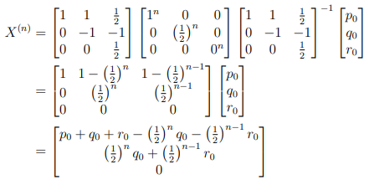
➔ We can write

Slide 22

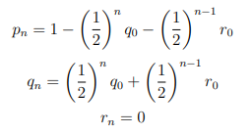
As the distribution is among the total population This implies

Slide 23


The given formulas provide a way to calculate the proportions of the three genotypes in the nth generation of plants, using the initial genotype fractions as inputs.
In longer run i.e., when
From above equations it follows ,
Based on the given formulas, it can be inferred that over time, the proportion of plants with genotype AA will eventually reach 100%.

Slide 24
Code for fast computation
import numpy as np
def calculate_pqr(p0, q0, r0, n):
pn = 1 - (1/2)**n * q0 - (1/2)**(n-1) * r0
qn = (1/2)**n * q0 + (1/2)**(n-1) * r0
rn = 0
return pn, qn, rn
def calculate_Xn(p0, q0, r0, n):
P = np.array([[1, 1/2, 0], [0, 1/2, 1], [0, 0, 0]])
X0 = np.array([p0, q0, r0])
C = np.array([[1, 1, 1/2], [0, -1, -1], [0, 0, 1/2]])
D = np.array([[1, 0, 0], [0, 1/2, 0], [0, 0, 0]])
C_inv = np.linalg.inv(C)

Slide 25
Pn = C @ np.linalg.matrix_power(D, n) @ C_inv
Xn = Pn @ X0
return Xn
# Example usage
p0 = 0.5
q0 = 0.3
r0 = 0.2
n = 3
p, q, r = calculate_pqr(p0, q0, r0, n)
print(f"p_n: {p}")
print(f"q_n: {q}")
print(f"r_n: {r}")
X = calculate_Xn(p0, q0, r0, n)
print(f"X^(n): {X}")

Slide 26
Code for the data visualization:
import numpy as np
import plotly.graph_objects as go
import plotly.io as pio
def calculate_pqr(p, q, r, n):
pn = 1 - (1/2)**n * q - (1/2)**(n-1) * r
qn = (1/2)**n * q + (1/2)**(n-1) * r
rn = 0
return pn, qn, rn
p = 0.5
q = 0.3
r = 0.2
n = 10

Slide 27
p_values = []
q_values = []
r_values = []
for i in range(n + 1):
pn, qn, rn = calculate_pqr(p, q, r, i)
p_values.append(pn)
q_values.append(qn)
r_values.append(rn)
fig = go.Figure()
fig.add_trace(go.Scatter(x=generation, y=p_values, mode='lines+markers', name='p’))
fig.add_trace(go.Scatter(x=generation, y=q_values, mode='lines+markers', name='q'))
fig.add_trace(go.Scatter(x=generation, y=r_values, mode='lines+markers', name='r'))
fig.update_layout(
title='Probability Dynamics',
xaxis_title='Generation',
yaxis_title='Probability',

Slide 28
showlegend=True,
legend=dict(x=0.9, y=0.9),
height=500,
width=800
)
pio.write_image(fig, 'graph.png’)
Here’s The plot:

Slide 29
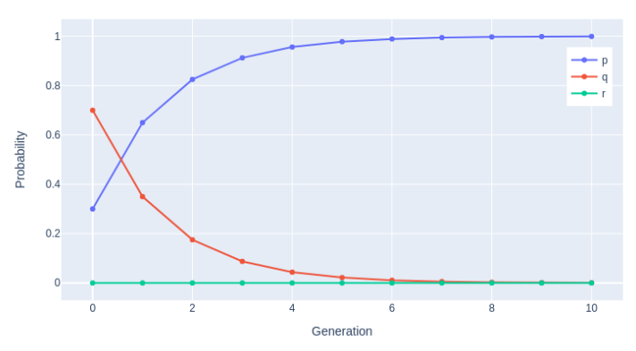

Slide 30
USES OF LINEAR ALGEBRA

Slide 31
1) Analysis of Genotype Distribution Using Linear Algebra
Introduction to the problem
Transition Matrix (P)
Matrix Equation (X(n) = PX(n-1))

Slide 32

2) Analysing Long-Term Genotype Distribution
Eigenvectors and Eigenvalues
Diagonalization (P = CDC^(-1))
Long-Term Distribution Equation ( )
By leveraging these concepts from linear algebra, we analyzes the steady-state distribution of genotypes in the population, understand the long-term behavior, and make predictions based on the initial genotype proportions.

Slide 33
Conclusion:
Linear algebra is an essential component in comprehending and examining genetic phenomena. It offers valuable methods for exploring the connections among alleles, genotypes, and phenotypes within populations. As the field of genetics progresses, the incorporation of linear algebraic techniques becomes increasingly important. These techniques empower us to extract valuable information from extensive datasets, unveil genetic patterns, and forecast genetic characteristics and population dynamics. The continued use of linear algebra will remain critical for modeling and comprehending the intricate relationships in genetics, fueling discoveries and advancements in the field.

